Slide 1
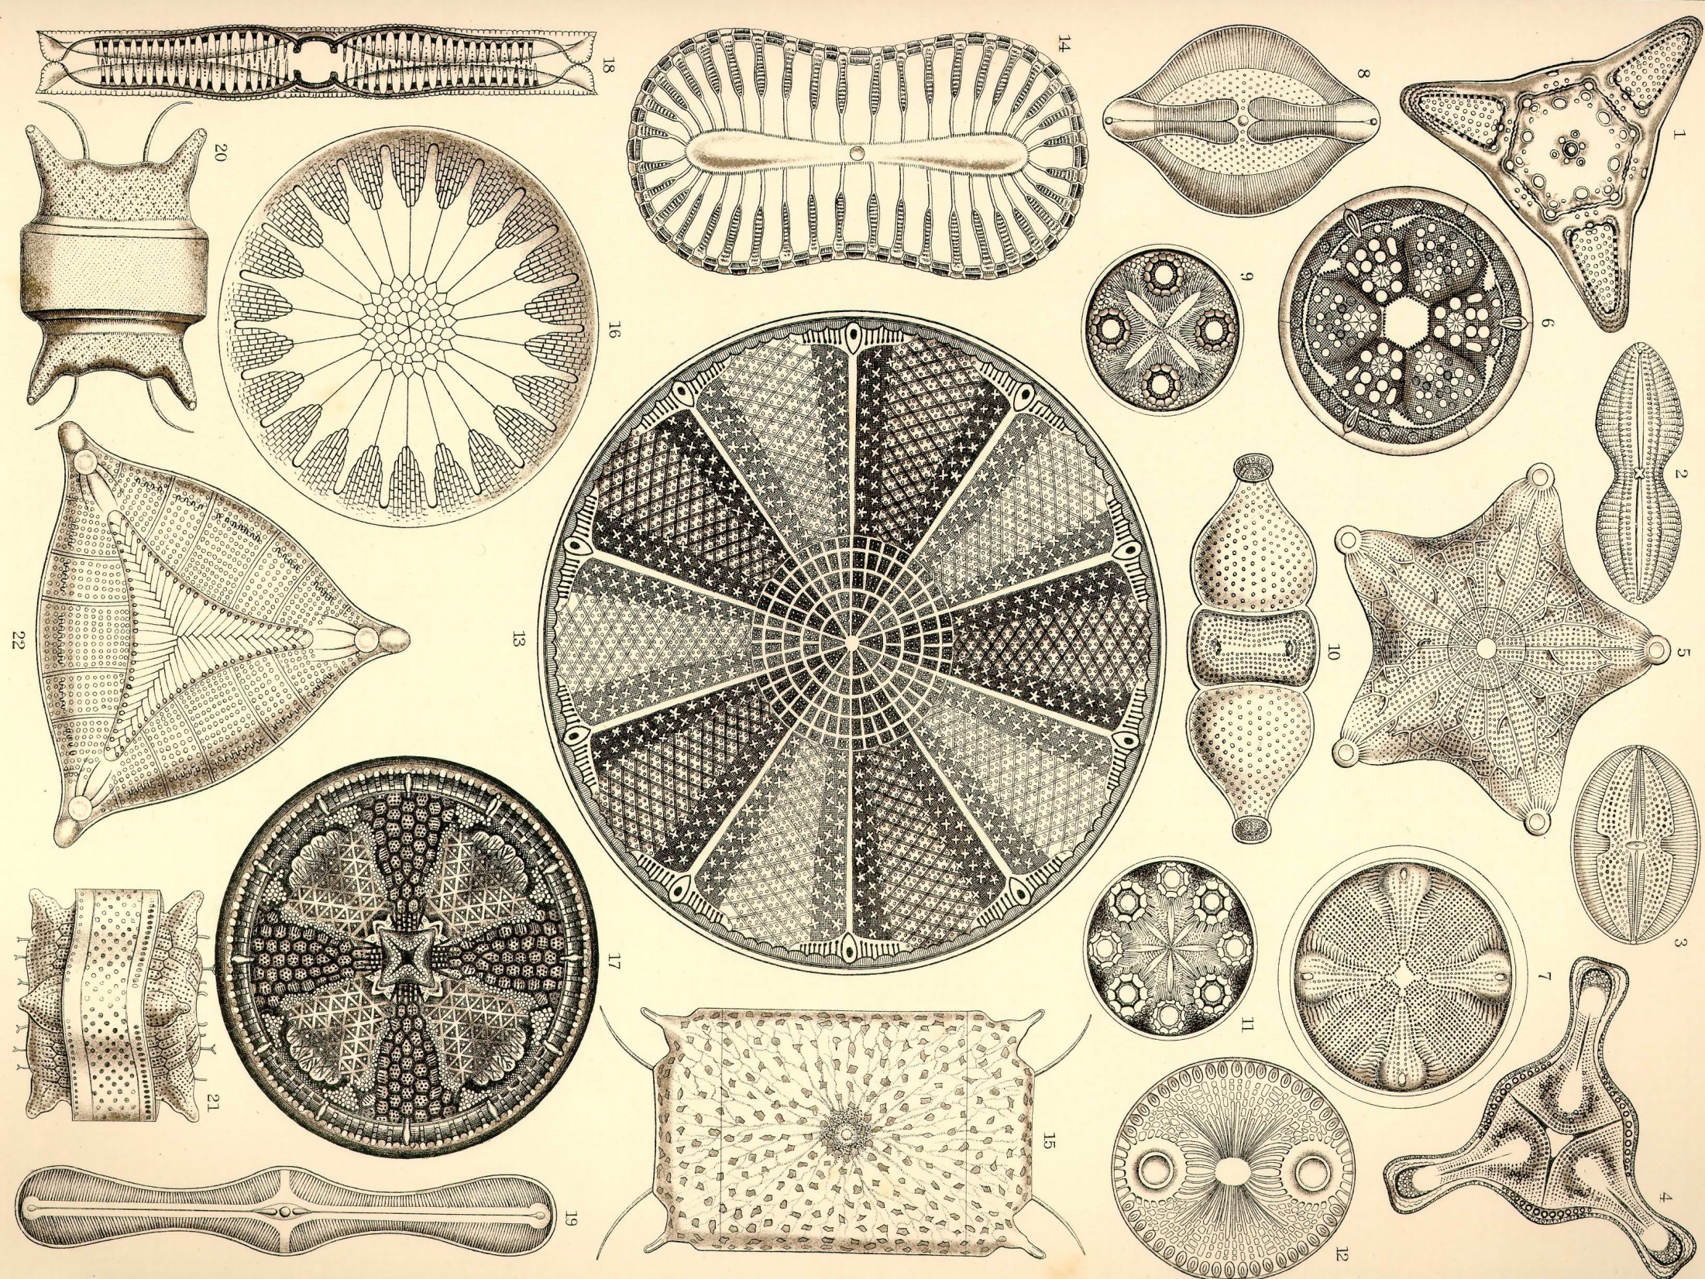
Coverage
Measuring and comparing Code Coverage
Notes:
Image: https://docs.google.com/open?id=0B8cYrKb6cTtOcjRKSFk1WE9faVU

Slide 2
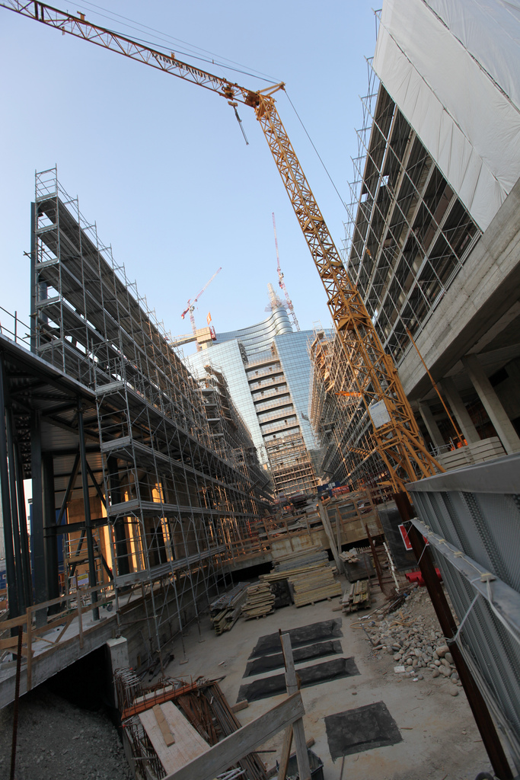
Work In Progress
Notes:
This is a project in active development.

Slide 3
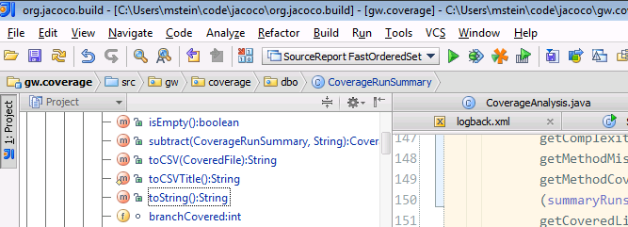
Opening Act: Coverage in IntelliJ
Notes:
IntelliJ has build-in coverage support.

Slide 4
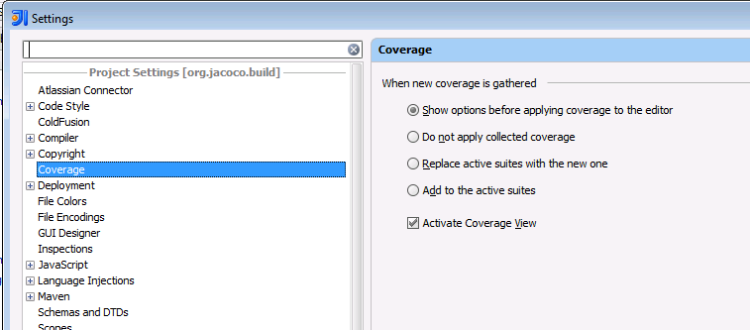
Turning on Coverage in IJ

Slide 5
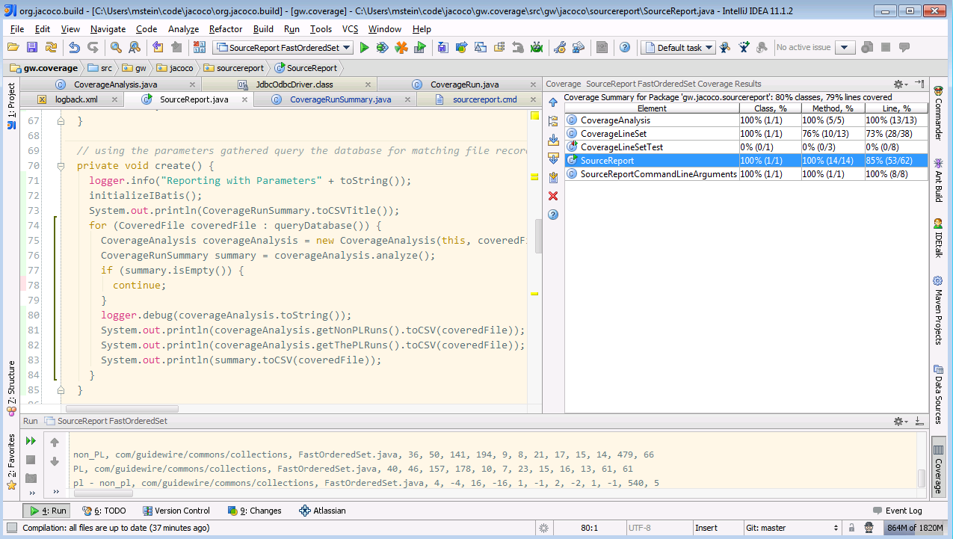
Coverage In IJ
Notes:
After pushing the ‘Run with Coverage’ button, a coverage report is shown, and the covered lines are colored green in the editor, uncovered ones in red.

Slide 6
Emerald Testing Project Goal
When running suites
App (non-PL) code
PL code base
Lines covered by PL suites
Lines covered by CC,PC,BC, …suites
Notes:
Find out which platform tests are missing and have to be written.
We wanted to find out when we run all the suites, which PL lines of code were covered only by non-PL tests.

Slide 7
A tool

Slide 8
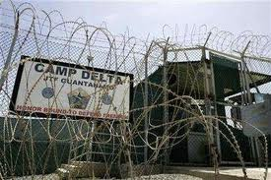
Integrate Into Gitmo

Slide 9

Available for Analysis

Slide 10
Plan
Pick an efficient OS coverage library.
Instrument PL and non-PL suite runs.
Gather PL code base coverage over time.
Analyze coverage data.
Put it into a database for easy analysis.
Write simple command-line tools for collection and exporting.
Rely on existing tools as much as possible.

Slide 11
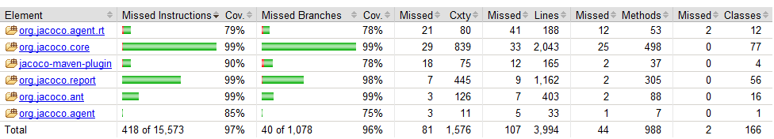
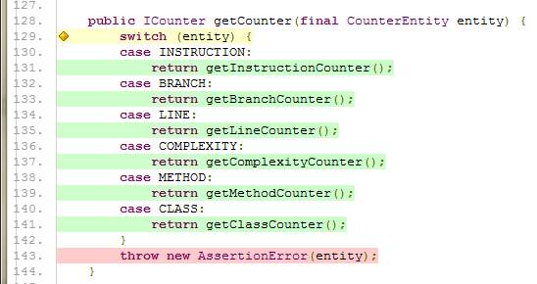
Jacoco reports
A one-run show.
Limited use.
Integrate into Jenkins/Sonar.
Notes:
Coverage tools create good looking reports that allow you to see coverage per project and run. They let you drill down into the source code.
But comparisons of runs is hard and basically a dual-monitor thing.
What is really the question we are trying to answer?

Slide 12
Jacoco
JaCoCo is a free code coverage library for Java, which has been created by the EclEmma team based on the lessons learned from using and integration existing libraries over the last five years.
http://www.eclemma.org/jacoco/index.html
Low overhead (2% - 30%) much less than Cobertura.
Notes:
We use Jacoco as an agent.

Slide 13
Counters
Instructions (C0 Coverage)
Branches (C1 Coverage)
Cyclomatic Complexity
Lines
Methods
Classes
Notes:
Instructions (C0 Coverage)
The smallest unit JaCoCo counts are single Java byte code instructions. Instruction coverage provides information about the amount of code that has been executed or missed. This metric is completely independent from source formatting and always available, even in absence of debug information in the class files.
Branches (C1 Coverage)
JaCoCo also calculates branch coverage for all if and switch statements. This metric counts the total number of such branches in a method and determines the number of executed or missed branches. Branch coverage is always available, even in absence of debug information in the class files. Note that exception handling is not considered as branches in the context of this counter definition.
If the class files haven been compiled with debug information decision points can be mapped to source lines and highlighted accordingly:
No coverage: No branches in the line has been executed (red diamond)
Partial coverage: Only a part of the branches in the line have been executed (yellow diamond)
Full coverage: All branches in the line have been executed (green diamond)
Cyclomatic Complexity
JaCoCo also calculates cyclomatic complexity for each non-abstract method and summarizes complexity for classes, packages and groups. According to its definition by McCabe1996 cyclomatic complexity is the minimum number of paths that can, in (linear) combination, generate all possible paths through a method. Thus the complexity value can serve as an indication for the number of unit test cases to fully cover a certain piece of software. Complexity figures can always be calculated, even in absence of debug information in the class files.
The formal definition of the cyclomatic complexity v(G) is based on the representation of a method's control flow graph as a directed graph:
v(G) = E - N + 2 Where E is the number of edges and N the number of nodes. JaCoCo calculates cyclomatic complexity of a method with the following equivalent equation based on the number of branches (B) and the number of decision points (D):
v(G) = B - D + 1 Based on the coverage status of each branch JaCoCo also calculates covered and missed complexity for each method. Missed complexity again is an indication for the number of test cases missing to fully cover a module. Note that as JaCoCo does not consider exception handling as branches try/catch blocks will also not increase complexity.
Lines
For all class files that have been compiled with debug information, coverage information for individual lines can be calculated. A source line is considered executed when at least one instruction that is assigned to this line has been executed.
Due to the fact that a single line typically compiles to multiple byte code instructions the source code highlighting shows three different status for each line containing source code:
No coverage: No instruction in the line has been executed (red background)
Partial coverage: Only a part of the instruction in the line have been executed (yellow background)
Full coverage: All instructions in the line have been executed (green background)
Methods
Each non-abstract method contains at least one instruction. A method is considered as executed when at least one instruction has been executed. As JaCoCo works on byte code level also constructors and static initializers are counted as methods. Some of these methods may not have a direct correspondence in Java source code, like implicit and thus generated default constructors or initializers for constants.
Classes
A class is considered as executed when at least one of its methods has been executed. Note that JaCoCo considers constructors as well as static initializers as methods. As Java interface types may contain static initializers such interfaces are also considered as executable classes.

Slide 14
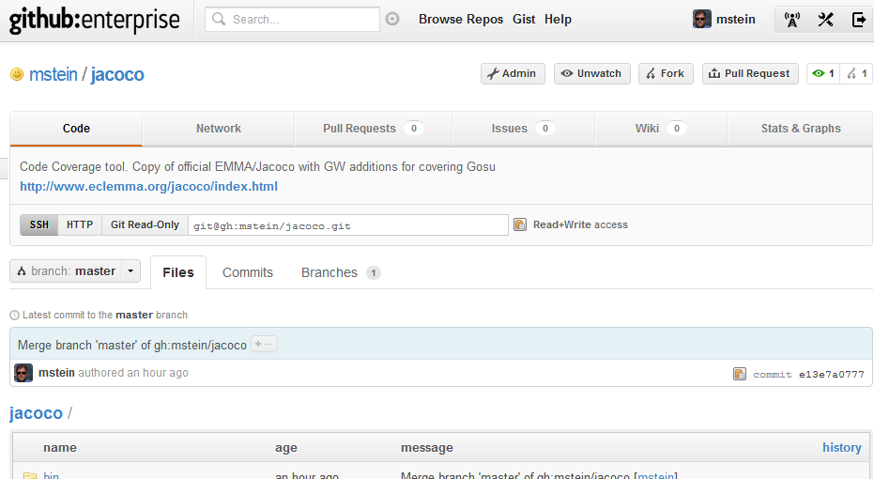
Guidewire Jacoco
Gosu
Better Reporting
Notes:
http://gh/mstein/jacoco
Jacoco was slightly modified to handle Gosu source code. Gosu byte code is captured and written to disk as class files.
The project needs to be separated from the clones Jacoco SVN source.
Should build fine in Maven and IntelliJ.
Still trying to figure out how to properly run the programs.

Slide 15
Jacoco and Gitmo
gitmo -coverage
platform/ant/public/gw/ant/test/TestRunner.gs
-javaagent:../jacocoagent.jar=destfile=${_resultDir}/jc-coverage-gitmo-${suiteNode.Class}.exec,includes=com.guidewire.*:gw.*"
org.osgi.framework.bootdelegation=org.jacoco.*
Notes:
When you run gitmo with the –coverage argument a java agent is passed to the test runner.
The test runner has to add the contents of the GW_COVERAGE environment variable to the VM arguments.
The java agent parameter string passes the name of the file where coverage information is collected in, which classes to include/exclude, etc.
I had to write a script that ran gitmo –coverage over all the suites, and copy coverage files to a directory.

Slide 16
Running lots of Suites with coverage
jacoco/bin/runSuites executes up to n Gitmos in parallel
How to write a shell script that limits the number of parallel processes? Trap CHLD
gitmo –coverage -branch eng_emerald_pl_ready_merge -change $change -suite $suite -perm 399 -mem 1399
cp /gitmo/auto/instance${num}/results/*.exec ~/coverage-results
Notes:
There is a script that runs a limited number of gitmo jobs in parallel. It takes a while to run them one after another and if you have a 16 core machine with 48GB of memory you can go wild.
It is also possible to run one suite at a time using gitmo –coverage. I hope that the TestRunner.gs runs all the suites.
After Gitmo has run it is a good idea to safe the .exec output file.

Slide 17


Coverage Reports
sqlreport to export coverage data into tables.
Excel to inspect package-level results.
sourcereport to aggregate the line-level coverage.
.class
Source coverage
sourcereport
Code
Agent
sqlreport
Package coverage
.exec
Notes:
The coverage information in the .exec files needs to be converted to human-readable form.
That is done via various reporting tools Jacoco provides.

Slide 18
sqlreport Options
Usage: <main class> [options] Gitmo result directory - just one
Options:
* -branch, -b branch name; e.g. d-pl-merge
Default:
-changelist, -c change list number; e.g. 443211
Default:
* -classesdir class directory, jar file. Can occur multiple times
Default: []
-createTables create the tables to write into before running.
needs DDL permissions.
Default: false
-debug Debug mode
Default: false
* -execfile, -e Jacoco execution file name
-jdbcconnection, -jdbc JDBC connection string
-runDate suite run date YYYY/MM/DD
* -suite, -s suite name; e.g. plv3barebones

Slide 19
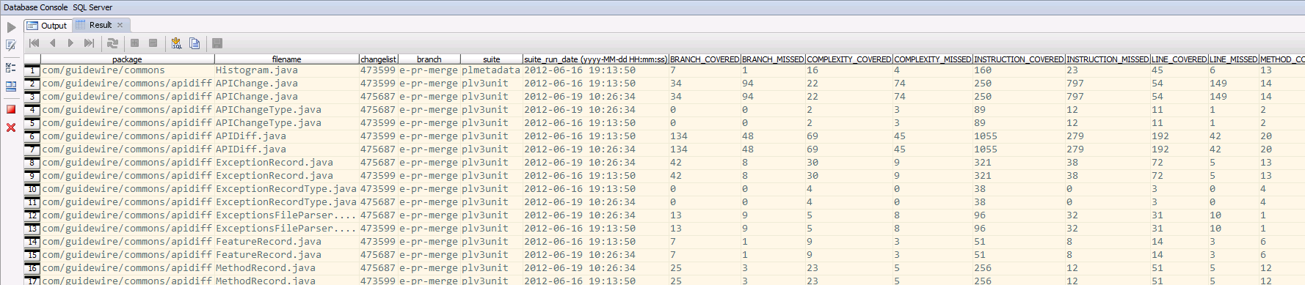
Coverage “Reports” From Jacoco to DB
Run sqlreport
First run with –createTables
Needs working –jdbc parameter
Two fact tables are being filled:
PACKAGE_COVERAGE
SOURCE_COVERAGE
Notes:
The coverage information in the .exec files needs to be converted to human-readable form.
That is done via various reporting tools Jacoco provides.

Slide 20
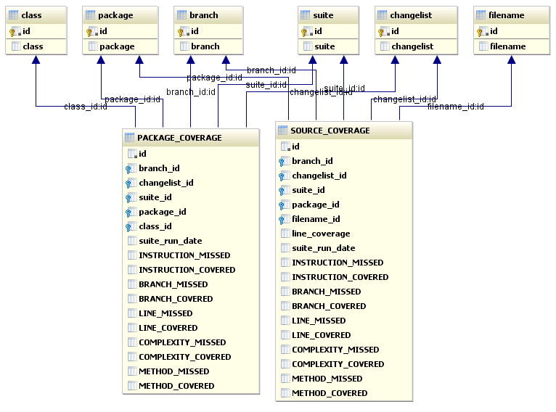
Reporting to a Database

Slide 21
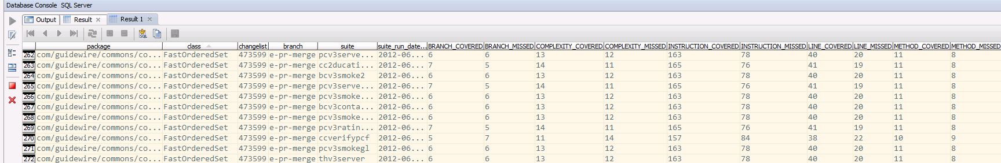
PACKAGE COVERAGE
p.package, f.class, c.changelist, b.branch, s.suite, suite_run_date,
BRANCH_COVERED, BRANCH_MISSED, COMPLEXITY_COVERED, COMPLEXITY_MISSED, INSTRUCTION_COVERED, INSTRUCTION_MISSED, LINE_COVERED, LINE_MISSED, METHOD_COVERED, METHOD_MISSED
Notes:
To see names instead of IDs for the dimensions:
select p.package, f.class, c.changelist, b.branch, s.suite, suite_run_date,
BRANCH_COVERED, BRANCH_MISSED, COMPLEXITY_COVERED, COMPLEXITY_MISSED, INSTRUCTION_COVERED, INSTRUCTION_MISSED, LINE_COVERED, LINE_MISSED, METHOD_COVERED, METHOD_MISSED
from package_coverage pc
join class f on pc.class_id = f.id
join package p on pc.package_id = p.id
join changelist c on pc.changelist_id = c.id
join branch b on pc.branch_id = b.id
join suite s on pc.suite_id = s.id
-- where instruction_covered > 0
--and c.changelist = '475259'
order by p.package, f.class;

Slide 22
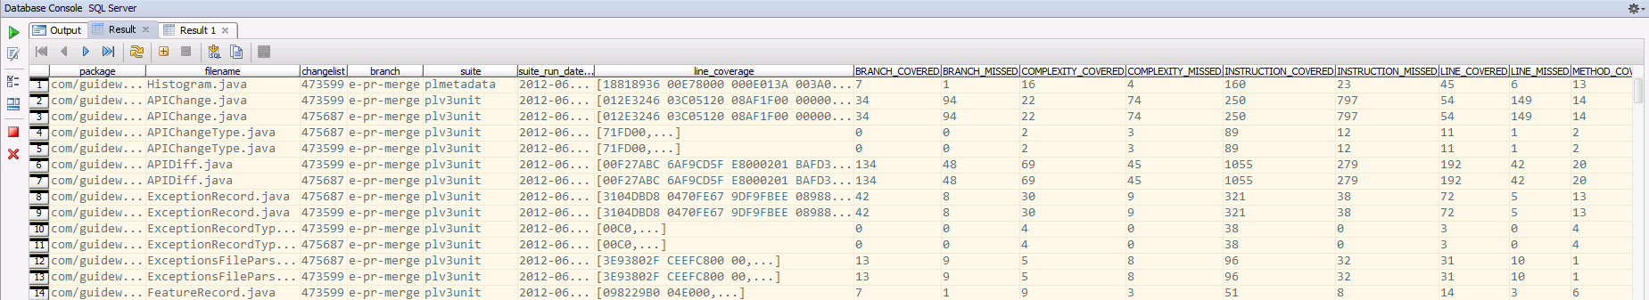
SOURCE COVERAGE
p.package, f.filename, c.changelist, b.branch, s.suite, suite_run_date,
BRANCH_COVERED, BRANCH_MISSED, COMPLEXITY_COVERED, COMPLEXITY_MISSED, INSTRUCTION_COVERED, INSTRUCTION_MISSED, LINE_COVERED, LINE_MISSED, METHOD_COVERED, METHOD_MISSED, line_coverage
Notes:
Here we are using a join to get the star-schema together:
select p.package, f.filename, c.changelist, b.branch, s.suite, suite_run_date,
BRANCH_COVERED, BRANCH_MISSED, COMPLEXITY_COVERED, COMPLEXITY_MISSED, INSTRUCTION_COVERED, INSTRUCTION_MISSED, LINE_COVERED, LINE_MISSED, METHOD_COVERED, METHOD_MISSED, line_coverage
from source_coverage sc
join filename f on sc.filename_id = f.id
join package p on sc.package_id = p.id
join changelist c on sc.changelist_id = c.id
join branch b on sc.branch_id = b.id
join suite s on sc.suite_id = s.id
where instruction_covered > 0
--and c.changelist = '475259'
order by p.package, f.filename;
Line coverage is a blob.

Slide 23
Reporting^2 – Aggregating
We have runs with class and line coverage in the database
Class coverage can be processed very well in Excel
File-level line coverage requires an additional tool

Slide 24
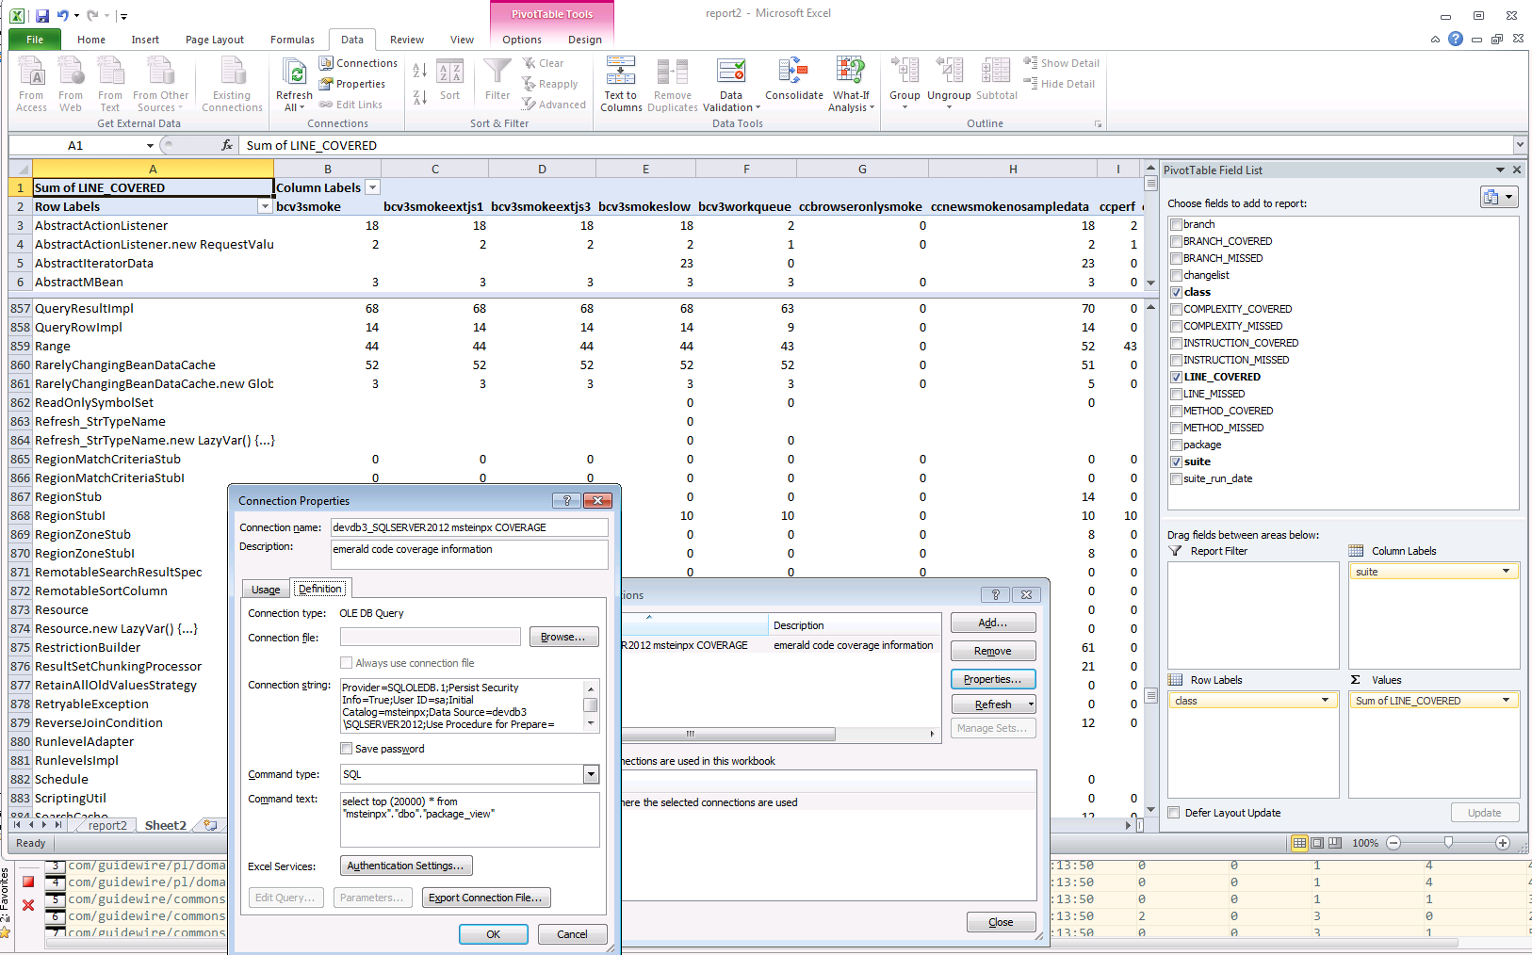
Reporting^3 - extracting Answers from Class Coverage
Demo: C:\Users\mstein\Documents\GW Presentations\Coverage report for source and package demo.xlsx
Notes:
Pivot tables in Excel are very powerful tools to look at data in various ways.
It is possible to connect Excel directly to a database view/table/SQL query.
Data/Connections
Provider=SQLOLEDB.1;Persist Security Info=True;User ID=sa;Initial Catalog=msteinpx;Data Source=devdb3\SQLSERVER2012;Use Procedure for Prepare=1;Auto Translate=True;Packet Size=4096;Workstation ID=MSTEIN-T3500;Use Encryption for Data=False;Tag with column collation when possible=False
Sa/Gw_123

Slide 25

Reporting^3 - Extracting Answers from Source Coverage Information

Slide 26
Comparing line coverage
File | Suite | coverage
FastSetImpl.java | CCnew | xxxx xxxxx x xxxx xx
 | CCext1 | xxxxxx xxxxx x xxxx xx
 | PCall | xxxxx
 | PLsuite1 | xxxxxx xxxxx xx
 | PLSuite2 | xxxxxx xxxxx
NextFile.java | CCsuite | …

Slide 27
Comparing line coverage
File | Suite | Coverage
FastSetImpl.java | CCnew | xxxx xxxxx x xxxx xx
 | CCext1 | xxxxxx xxxxx x xxxx xx
 | PCall | xxxxx
Aggregate (OR) |  | xxxxxxx xxxxx x xxxx xx | 19
 | PLsuite1 | xxxxxx xxxxx xx
 | PLSuite2 | xxxxxx xxxxx
Aggregate (OR) |  | xxxxxx xxxxx xx | 13
Non-PL AND NOT PL |  | x xxxx xx | 6
Notes:
We want to see the lines that are covered in non-PL suites but not in PL suites, so we can find the PL files lacking test coverage.
In the example we can see that 6 lines covered in CC and PC tests are not covered in PL tests.
The coverage information on classes can’t be compared well for groups of suite runs
What if both runs cover a different 50%?
Have to extract line coverage per run.
Then aggregate line coverage across suites (OR)
Finally compare non-PL with PL (AND NOT)
It would be great if one could query the source coverage blobs using blob bitmask aggregate functions.
Or code it in Java: sourcereport

Slide 28
sourcereport
Generate CSV output that can be imported into Excel.
Needs a 64-bit VM and currently 4+GB of memory!
Demo:
[gitmo@devtestx1 bin]$ ./sourcereport -file FastOrderedSet.java 2>log
title, PackageName, FileName, lineMissed, lineCovered, instructionMissed, instructionCovered, branchMissed, branchCovered, complexityMissed, complexityCovered, methodMissed, methodCovered, line coverage difference CoveredLineSet cardinality
non_PL, com/guidewire/commons/collections, FastOrderedSet.java, 117, 237, 662, 1175, 24, 23, 68, 61, 43, 51, 66
PL, com/guidewire/commons/collections, FastOrderedSet.java, 134, 225, 614, 911, 26, 24, 76, 57, 46, 50, 61
pl - non_pl, com/guidewire/commons/collections, FastOrderedSet.java, -17, 12, 48, 264, -2, -1, -8, 4, -3, 1, 5

Slide 29
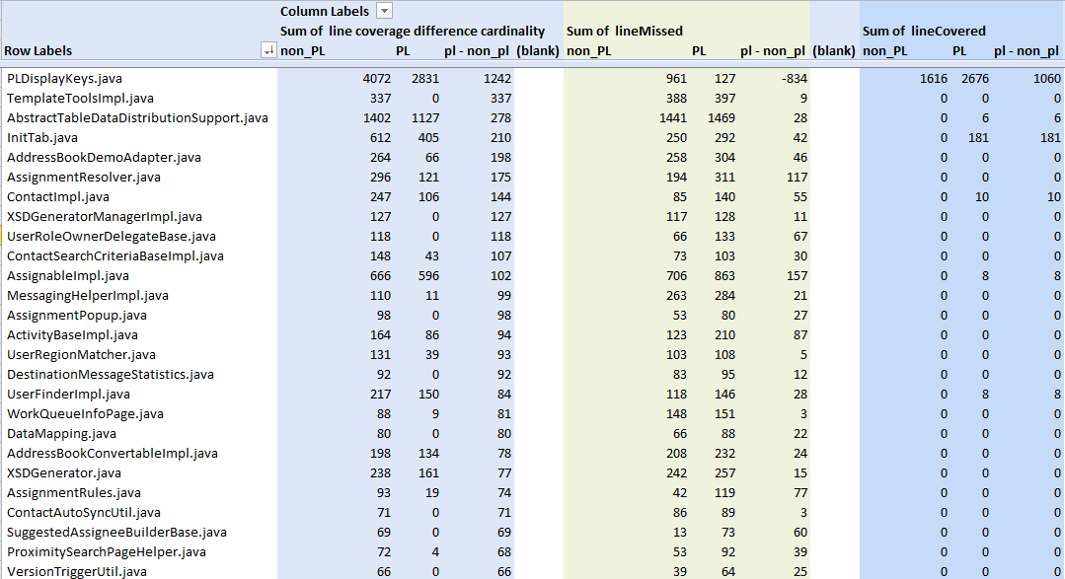
Source Report
Demo: C:\Users\mstein\Documents\GW Presentations\Coverage report for source and package demo.xlsx

Slide 30
Libraries used
<dependency>
<groupId>com.h2database</groupId>
<artifactId>h2</artifactId>
<version>1.3.165</version>
</dependency>
<dependency>
<groupId>gw.managed</groupId>
<artifactId>sqljdbc4</artifactId>
<version>4.0.2206.100</version>
</dependency>
<!--command line arguments -->
<dependency>
<groupId>com.beust</groupId>
<artifactId>jcommander</artifactId>
<version>1.20</version>
</dependency>
<dependency>
<groupId>org.mybatis</groupId>
<artifactId>mybatis</artifactId>
<version>3.0.6</version>
</dependency>
<dependency>
<groupId>ch.qos.logback</groupId>
<artifactId>logback-core</artifactId>
<version>1.0.4</version>
</dependency>
<dependency>
<groupId>ch.qos.logback</groupId>
<artifactId>logback-classic</artifactId>
<version>1.0.4</version>
</dependency>
<dependency>
<groupId>org.slf4j</groupId>
<artifactId>slf4j-api</artifactId>
<version>1.6.4</version>
</dependency>

